Slide 1
Notes:
Welcome to HSC! First of all I thought Id Just to dispel some myths around this subject: Its not studied at Key stage 3, so this is a new subject for each student. Its not just for girls. Boys are just as welcome! Its not a ‘soft’ or ‘easy’ subject – students have an external exam at the end of Y11 and two long coursework's to complete in Y10 to achieve the qualification. Students have to independently conduct their own research and do an assessed interview for one mandatory coursework, as well as researching and performing their own creative therapeutic activity for their other mandatory coursework . Its not ‘child care’ – its so much more! So what is it? It is a course that is relevant to everyone and provides young people with an introduction to all the skills, knowledge and attitudes needed to be successful in the health and social care sector.

Slide 2
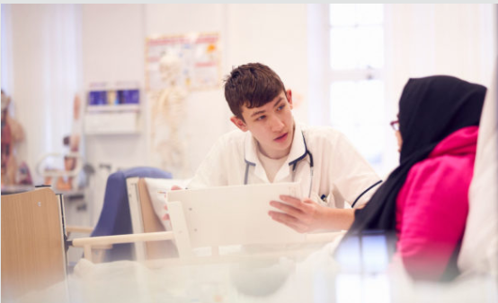
Why should you study Health and Social Care?
Notes:
If the idea of a career in the health sector such as adult nurse, learning disability nurse, mental health nurse, paediatric nurse, carer in residential care, midwife, paramedic, occupational therapist, dental nurse or a physiotherapist intrigues you then this is the course for you.
If you have ambitions to work in social care, such as being a social worker, youth worker, nanny, childminder, primary school teacher, then this is the course for you. This course is for young people who have a passion for helping people, especially the most vulnerable in society.
Due to an aging population Health & Social Care is one of the fastest growing sectors in the UK and the NHS remains the largest employer in the UK and the 5th largest employer in the world employing over 1.3million people. In York and North Yorkshire, Health and Social Work employs 13% of all employees, so there is a big job market and future out there that could start by studying HSC at Thirsk.

Slide 3
What will I study?
In Year 10 you will complete two coursework units:
In Year 11: One mandatory, examined unit, marked externally by OCR
Supporting Individuals through life events
Topics include:
Life stages; Impacts of life events; Sources of support
Creative and Therapeutic activities
Topics include:
Therapies and their benefits; creative activities and their benefits; how to plan, deliver and evaluate a creative activity for individuals in a HSC setting.
Principles of Care in Health and Social Care Settings
Topics include:
The rights of service users; person centered values; effective communication; safeguarding procedures; infection control; conducting risk assessments; safety and security measures.
Notes:
So what would you actually study? Well in Y10 you have to complete 2 different coursework units, both of which heavily rely on independent research, so you tailor your coursework to your interests. The first one is abut exploring life stages-looking at the PIES development of individuals at different life stages and how life events such as bankruptcy, divorce, marriage, employment, illness can affect peoples mental and physical wellbeing. Students conduct an interview of their case study that is assessed and look at the impact of life events on their casestudy. The second coursework unit in Y10 is based on therapies – where students explore what creative and therapeutic therapies are and how these can be applied to individual. Students research their own case study and conduct an assessed activity to discuss the benefits and impacts of their therapy on their chosen individual. And then in Y11 their time is spent working towards their external exam that has to be sat in Y11. Main topics include rights of service users, verbal and non verbal communication, conducting risk assessments, infection control and personalisation, why person centred values are so important in HSC.

Slide 4
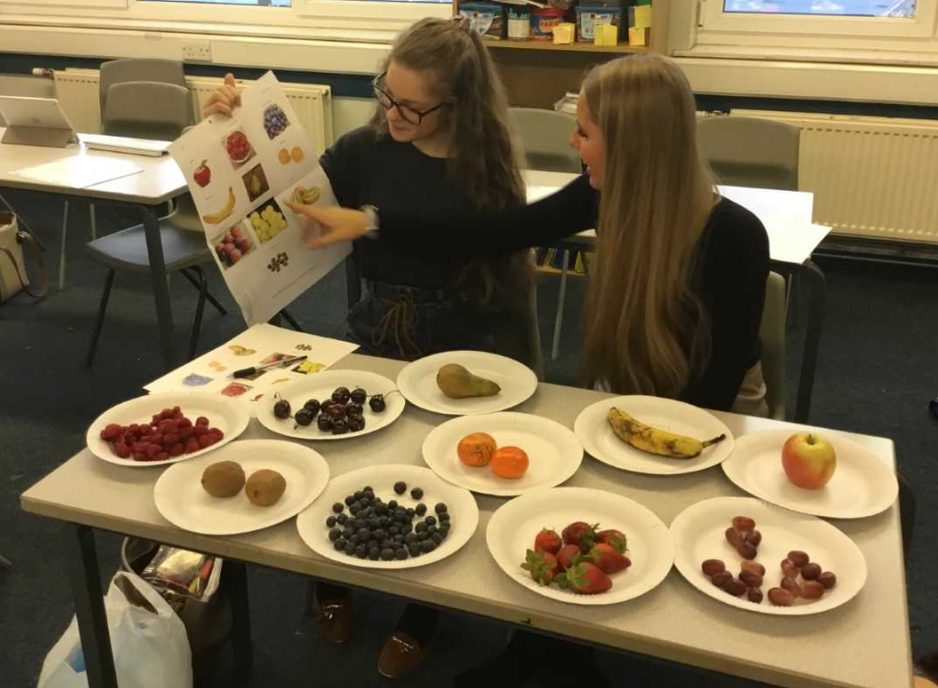
Skills developed during this course
Effective verbal communication
Presentation skills
Creative thinking
Problem solving research and planning
Meeting coursework deadlines
Answering exam questions
Notes:
When students conduct their assessed interviews, research the life events their induvial experiences, and their impacts, they will develop valuable verbal and non verbal communication skills, independent research skills and writing at length using facts and empathy. When students conduct their creative and therapeutic coursework, they will plan and deliver an assessed therapy to individuals, again developing their oracy, problem solving and evaluation skills, as well as their awareness of conducting risk assessments and budgeting. The coursework units also encourage self discipline around meeting deadlines and application of theory whilst the exam unit develops vital revision and clarity of writing and explanations.

Slide 5
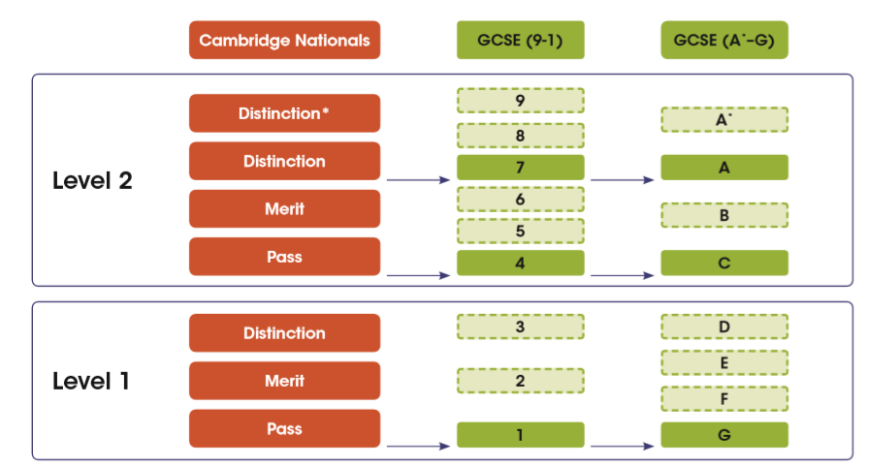
Summary of assessment
Regular assessment of coursework as the year progresses, and end of unit tests and mock exams before the final external exam in Year 11
The exam contributes 40% overall mark
Each coursework unit contributes 30% overall mark

Slide 6
What does the subject lead on to?
The course is an excellent foundation to
Further study: Level 3 Health and Social Care, here at Thirsk School and Sixth Form.
Extended Certificate (equivalent to 1 A Level),
or the Diploma (equivalent to 2 A Levels).
Apprenticeships
Notes:
NHS-over 350 apprenticeship ambulance practitioner; Dental Nursing; nursing; Healthcare science assistant;
Maternity and Paediatric Support;Pharmacy services assistant (level 2)

Slide 7
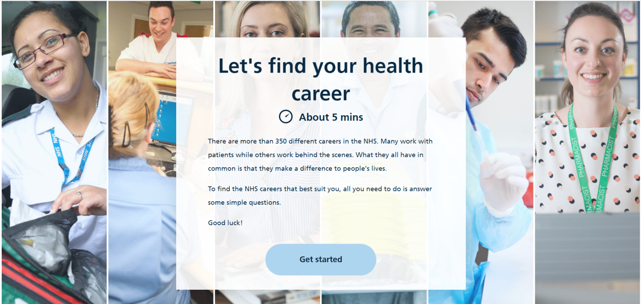
Finally….
Google NHS careers quiz https://www.healthcareers.nhs.uk/findyourcareer
Notes:
If you're interested but unsure of where your interests may lie in the health and social care sector, a really good starting point to explore roles is to take the NHS careers quiz to help see where your preferences and strengths may take you.

Slide 8
Contact information
Head of Health and Social Care
Mrs Fletcher
Tori.fletcher@thirskschool.org
Mrs Gabler

